Slide 1

ECON F315/FIN F315 FINANCIAL MANAGEMENT
GRP-10

Slide 2
Group Members
Farhad Reheman - 2021A4PS1393H
Aditya Dibyadarshan Mohanty - 2021A4PS2419H
Abhinav Satish - 2021AAPS1525H
Sarthak Agarwal - 2021A4PS3087H
Soumya Choudhury - 2021A7PS2674H

Slide 3
About WACC
The weighted average cost of capital (WACC) is the average rate that a business pays to finance its assets. It is calculated by averaging the rate of all of the company's sources of capital (both debt and equity), weighted by the proportion of each component.
In this case, we have considered the Equity component and Debt component
So we have to calculate the cost of equity and cost of debt along with the weight of each component.

Slide 4
Calculating Cost of Equity
Cost of Equity is the rate of return a company pays to equity investors. We can use the CAPM model to calculate the cost of equity. The capital asset pricing model - or CAPM - is a financial model that calculates the expected rate of return for an asset or investment. CAPM does this by using the expected return on both the market and a risk-free asset, and the asset's correlation or sensitivity to the market (beta).
We can use the average return of NIFTY50 over the time period as expected return of market and take the average bond yield of 10 year Indian Bond for the expected return of risk free asset. The only problem is getting the beta value as it varies from company to company.
We can calculate the beta value by either using the top down approach or bottom up approach.

Slide 5
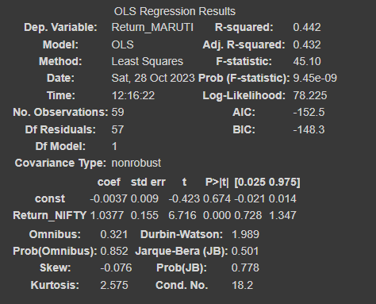
Calculating Beta and Cost of Equity through Top Down Approach
To calculate the beta of Maruti Suzuki India Ltd using the top down approach we have to run a regression with dependent variable as target company monthly returns and independent variable as market returns(NIFTY50). The beta we obtain is the beta levered of Maruti Suzuki India Ltd.
In this case, we get beta levered as 1.0377

Slide 6
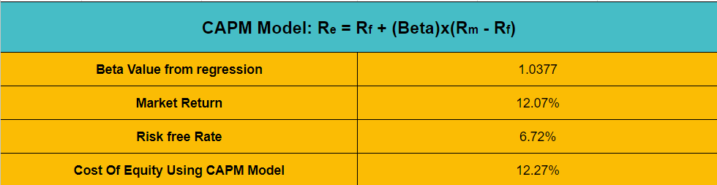
Now that we have the beta levered of the target company,we can use the CAPM model to get the cost of equity required
So the cost of equity of Maruti Suzuki India Ltd through top down approach is 12.27%

Slide 7
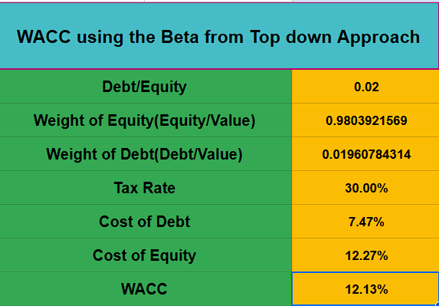
WACC using the Beta from Top down Approach
WACC = Rb (1-T)Wb + RpWp + RsWs

Slide 8
2) Calculating Beta and Cost of Equity through Bottom Up Approach
To calculate the beta of Maruti Suzuki India Ltd using the top down approach we have to run a regression with dependent variable as target company monthly returns and independent variable as market returns(NIFTY50). The beta we obtain is the beta levered of Maruti Suzuki India Ltd.
In this case, we get beta levered as 1.102232912

Slide 9
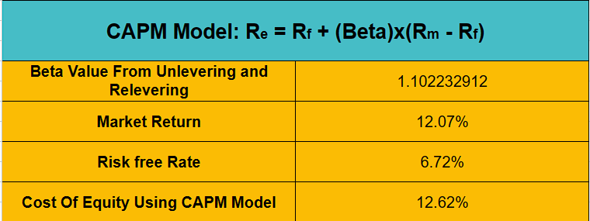
Now that we have the beta levered of the target company,we can use the CAPM model to get the cost of equity required
So the cost of equity of Maruti Suzuki India Ltd through top down approach is 12.62%

Slide 10
3) Calculating Cost of Debt
The cost of debt is the total interest expense owed on a debt. To calculate this, we obtain the values of EBIT and the Interest expense from each quarter (namely 22’ Q2 to 19’Q2). Earnings before Interest and Taxes (EBIT) is a measure of a firm’s profit, that includes all incomes and expenses but does not consider Interest expenses and Tax expenses.
We can then divide the EBIT value and Interest expense value of each quarter to obtain the Interest Coverage ratio. The Interest coverage ratio is used to determine how easily a company can pay interest on its outstanding debt
To maintain consistency during calculations, we take a single Interest Coverage ratio value. This value is calculated by taking the average of the Interest Coverage ratios of each quarter.

Slide 11
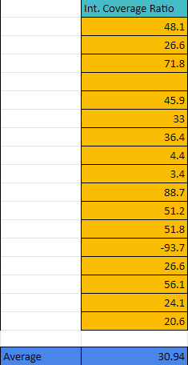
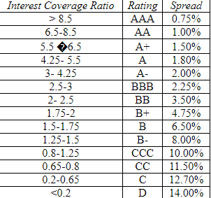
We then use our obtained ratio and find out its corresponding default risk premium. We also find out the average risk free rate across the same time period (Which comes to around 6.72%) .

Slide 12
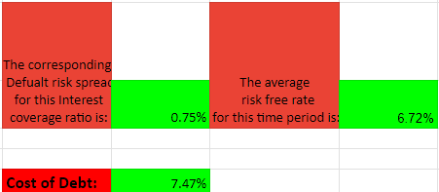
Finally, we can find out the cost of debt by adding the average risk free rate with our obtained default risk premium value.
.

Slide 13
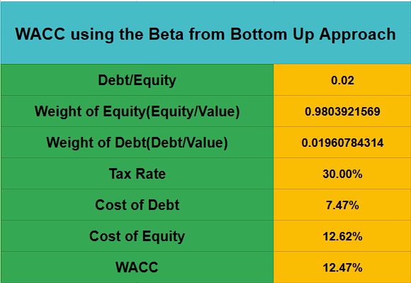
WACC using the Beta from Bottom Up Approach
WACC = Rb (1-T)Wb + RpWp + RsWs

Slide 14
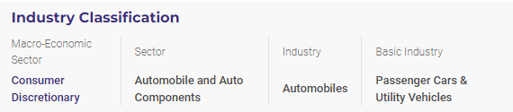
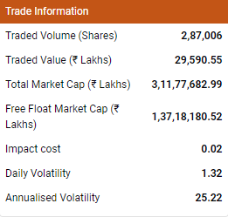
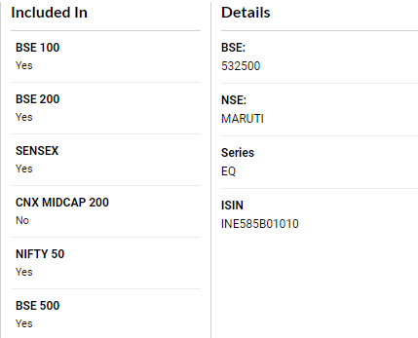
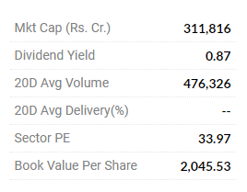
Market Cap and Industry information

Slide 15
Board of Directors
Mr. R. C. Bhargava - Chairman
Mr. Hisashi Takeuchi - Managing Director & CEO
Mr. Kenichi Ayukawa - Director
Mr. Shigetoshi Torii - Director
Mr. Toshihiro Suzuki - Director
Mr. Kenichiro Toyofuku - Director(Corporate PLanning)
Mr. Osamu Suzuki - Director
Mr. Kinji Saito - Director
Mr. D. S. Brar - Independent Director
Mr. R.P. Singh - Independent Director
Mr. Maheswar Sahu - Independent Director
Ms. Lira Goswami - Independent Director

Slide 16
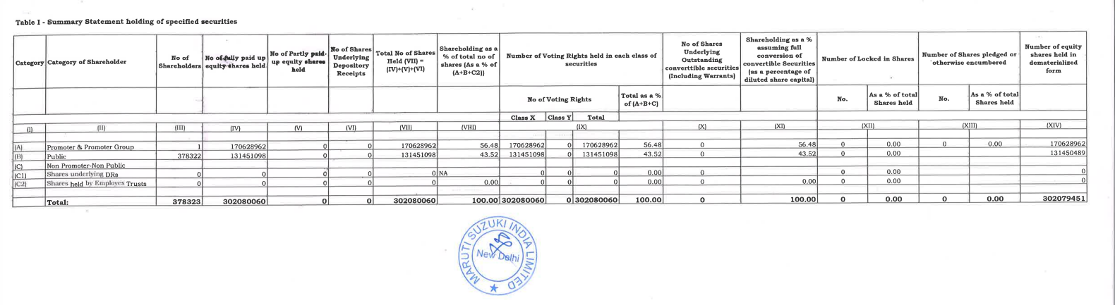
Shareholding Pattern

Slide 17
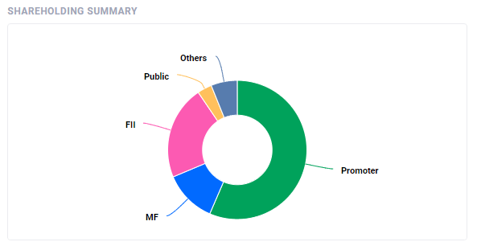
Shareholder Summary

Slide 18
References
https://www.moneycontrol.com/india/stockpricequote/auto-carsjeeps/marutisuzukiindia/MS24
https://www.nseindia.com/get-quotes/equity?symbol=MARUTI
https://www.marutisuzuki.com/corporate/investors
https://trendlyne.com/equity/share-holding/842/MARUTI/latest/maruti-suzuki-india-ltd/#:~:text=Mutual%20Funds%20have%20increased%20holdings,40.14%25%20in%20Sep%202023%20qtr.
https://finance.yahoo.com/quote/MARUTI.NS?p=MARUTI.NS&.tsrc=fin-srch

